Slide 1
Doug Bishop Lecture 6
GENE314/BIOS21236
GAMO
Finding functional interactions between genes/ Genomics
Suppressor Selection
-Single copy suppressor mutations
Structural/Interaction suppressors
Bypass suppressors
-High Copy suppressor mutation
Synthetic Lethality Screening
Two-hybrid Selection/Screening
Expression profiling with hybridization Arrays and RNA Seq.
Functional profiling with the Knock-out collection
Comparison of functional and expression profiling: Closing lesson on the importance of mutants in the analysis of function.
Notes:
<number>

Slide 2
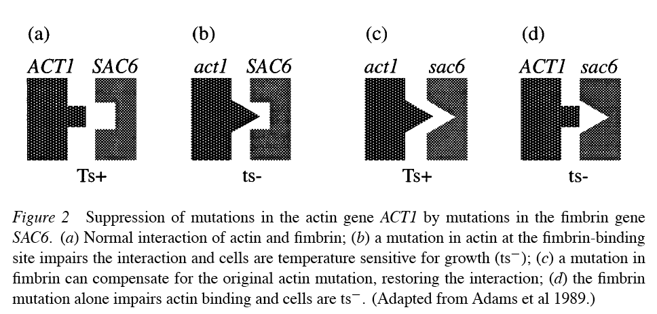
Structural supressors = supressors of defects in protein-protein interactions
m1
m2
m2
m1
often
(or cs)

Slide 4
Intragenic suppression by Compensation for a structural defect I: restoration of folding
m1
m2
m1
Functional
Non-functional
Functional

Slide 5
Intragenic suppression by Compensation for a structural defect II: dimerization
m1
m2
m1
m2
m1
m1
Functional
Functional
Non-functional

Slide 6
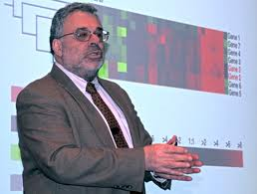
Suppressors of ts mutations
Isolate unlinked suppressors of ts mutants.
Separated suppressors from “parental mutations.”
Found suppressors mutations sometimes conferred phenotypes of their own—i.e. as single mutants.
Suppressors often turn out to be altered versions of proteins known to bind directly to the protein altered in the original mutant.
Once suppressor genes identified, want to determine function:
1-identify gene and obtain clues from informatics
2-mutant phenotype when separated from original mutation and/or when a null mutant is constructed by reverse genetics.
3-cell biological and biochemical analysis of protein location and activity.
David Botstein

Slide 7
Properties of Interaction Suppressor Mutations
Allele-specific: If suppression restores a protein-protein interaction then the suppressor mutation will not suppress the phenotype of a deletion allele; suppressor activity is specific for the mutant background that was originally used to identify the suppressor.
Suppression is dominant (usually).
Suppressor mutations may confer defects alone, i.e. when separated from the parental mutation.
If a suppressor mutation does confer such a defect as a single mutant, that defect is often recessive.
The genes identified as suppressors often function on the same pathway as, or form a protein complex with, the mutant defect rescued by the suppressor allele.

Slide 8
How to isolate structural suppressors
Choose a ts or other leaky recessive mutation in a haploid
(defect that a secondary change can correct). If you use a null allele, you will get bypass suppressors, not structural suppressors.
Hypothetical example:
gal1-ts cannot grow at 37ºC on plates
in which galactose is the only carbon source. This mutant strain
grows fine on Gal plates at 17ºC.
Isolating suppressors is popular BECAUSE one can usually carry out a selection for them.
Make multiple mutagenized pools of a gal-1ts strain with EMS treatment.
Isolate strains with the suppressed phenotype: ability to grown on Gal at 37ºC..

Slide 9
How to characterize suppressors
Does my strain have a dominant or recessive suppressor?
Is the suppressor phenotype the result of a single mutation?
Cross suppressed strains to the original unsuppressed strain with gal1-ts mutant
= gal1-ts SUP1⁺
Two possibilities….
gal1-ts/gal1-ts SUP1⁺/sup1 or gal1-ts/gal1-ts SUP1⁺/SUP1
Phenotype=? Phenotype=?
Analyze diploid. Growth on Gal at 37ºC =dominant, NO growth=recessive
Carry out segregation analysis. Is suppression caused by a simple
Mendelian trait? …i.e. segregates 2:2 in tetrads?

Slide 10
How to characterize suppressors
Does my suppressor mutation confer a phenotype on its own?
Cross suppressed haploid to WT haploid strain.
gal1-ts SUP1
x
GAL1⁺ SUP1⁺
gal1-ts SUP1
GAL1⁺ SUP1⁺
Assume suppressor locus unlinked to GAL1 locus
Case #1 no phenotype alone (=bummer)
PD
Gal
T
Gal
NPD
Gal
gal1
SUP1
+
gal1
SUP1
+
gal1
SUP1⁺
ts
gal1
SUP1
+
gal1
SUP1⁺
ts
gal1
SUP1⁺
ts
GAL1⁺
SUP1⁺
+
GAL1⁺
SUP1
+
GAL1⁺
SUP1
+
GAL1⁺
SUP1⁺
+
GAL1⁺
SUP1⁺
+
GAL1⁺
SUP1
+
1
4
1
Notes:
<number>

Slide 11
How to characterize suppressors
gal1-ts SUP1
GAL1⁺ SUP1⁺
Case #2 suppressor has a distinct phenotype
when separated from the starting mutation (better)
(in this case new phenotype is cold sensitive=cs)
PD
Gal
T
Gal
NPD
Gal
gal1
SUP1
+
gal1
SUP1
+
gal1
SUP1⁺
ts
gal1
SUP1
+
gal1
SUP1⁺
ts
gal1
SUP1⁺
ts
GAL1⁺
SUP1⁺
+
GAL1⁺
SUP1
cs
GAL1⁺
SUP1
cs
GAL1⁺
SUP1⁺
+
GAL1⁺
SUP1⁺
+
GAL1⁺
SUP1
cs
1
4
1

Slide 12
Review of cloning genes in yeast: How would you clone suppressor genes?
…if they had a recessive phenotype (growth defect) as single mutant?
…if they only confer phenotype in the background of the original mutation and are recessive?
…if they only confer a phenotype in the background of the original mutation and suppression is dominant?

Slide 13
Bypass suppressors
Unlike interaction (structural) suppressors, bypass suppressors are
not usually allele-specific. Null mutations are can be suppressed.
mut1
Y
Z
X to Y irreversible
Can’t make Z
Formal diagram
X
W
Z’
Notes:
<number>

Slide 14
Bypass suppressors
Formal diagram
mut1
sup1
Y
Z
Suppressor mutation
Allows X to be processed
by an alternative mechanism
X
W
Z’
Often, bypass suppressors do not completely restore the wild type phenotype.
Example:
The low spore viability of a spo11 mutant is caused by non-disjunction at the first meiotic
division.
spo13 mutations rescue the spore viability defect caused by spo11 mutation, but the result
is not a normal meiotic division, it is an equasional (i.e. mitotic like division)
Notes:
<number>

Slide 15
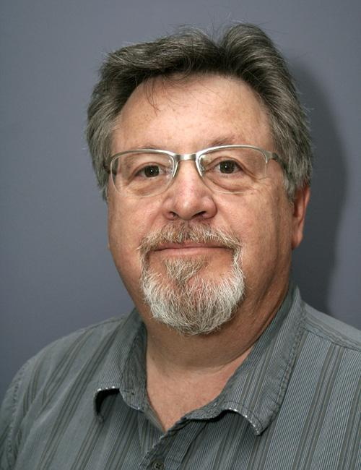
Bypass of regulatory circuits
WT
mutant lacking B
bypass suppressor
in A
B
A
A*
A
A^{S}
activity
no activity
activity
Cdc7=kinase that phosphorylates, and thereby activates, a protein complex called the Mcm complex that is required for replication.
The CDC7 gene is an essential gene. Bob Sclafani isolated a mutation in the MCM5 gene, called mcm5-bob1, that rescues growth in cdc7 null mutants. The Mcm5-bob1 mutant protein is thought to alter the conformation of the Mcm complex in a manner that mimics activation by Cdc7 kinase.
Bob Sclafani

Slide 16
High Copy (Dosage) Suppressors
Transform a genomic library of plasmids that uses a high-copy, 2-micron or YEp vector.
Bypass suppression
Turn up expression of a key component of an alternative pathway.
Create an earlier block that allows entry into an alternative pathway.
Overwhelm a negative regulator
Structural suppression (e.g. if you start with a mutation that reduces affinity for a partner protein).
This is easier than isolating EMS mutants because it is easy to recover suppressor plasmids into E. coli and identify the suppressor genes. Just make DNA from the yeast strain and transform E. coli.
Notes:
<number>

Slide 17
Synthetic Lethality
Find mutations that confer a lethal phenotype, but
only in a specific mutant background.
Can be thought of as the opposite of genetic suppressors.
Also a method to find genes that are functionally related to a starting gene.
If parental allele is a partial loss-of-function allele,
It is possible to get synthetic lethals that are also partial loss-of-function on the same pathway.
If parental allele=null allele, more likely to get
mutations that block a parallel (redundant) pathway.
This is an extreme example of “phenotypic enhancement” in which adding a second mutation makes the phenotype conferred by the first mutation more severe. It is common for Drosophila geneticists like to look for phenotypic enhancement AND phenotypic suppression in the same screen.
Notes:
<number>

Slide 18
Synthetic Lethals
YFG=your favorite gene
mutagenize
host
LEU2
CYH^{s}
leu2 cyhR
yfg-
YFG⁺
Find mutations that cause death
But only in a yfg⁻ background
Patch clones of mutant cells on rich medium.
Growth without selection allows occasional plasmid loss.
Do the cells that lose the plasmid continue to grow? If not,
then you have a synthetic lethal.
Replica
Plate
+Cyh
-Leu
Notes:
<number>

Slide 19
Synthetic Lethals
Patch of cells
LEU2
CYH^{s}
mutX
leu2 cyhR
yfg-
+Cyh
YFG⁺
If combination of mutX and yfg inviable
the cells in the patch that happen to lose the plasmid
will eventually die.
Thus, there will be no growth after replica plating to
Cyh plates.
This allows you to identify mutations that cause
death in combination with your favorite mutation.
-Leu
Notes:
<number>

Slide 20
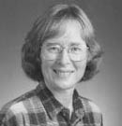
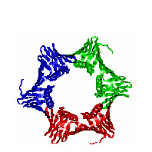
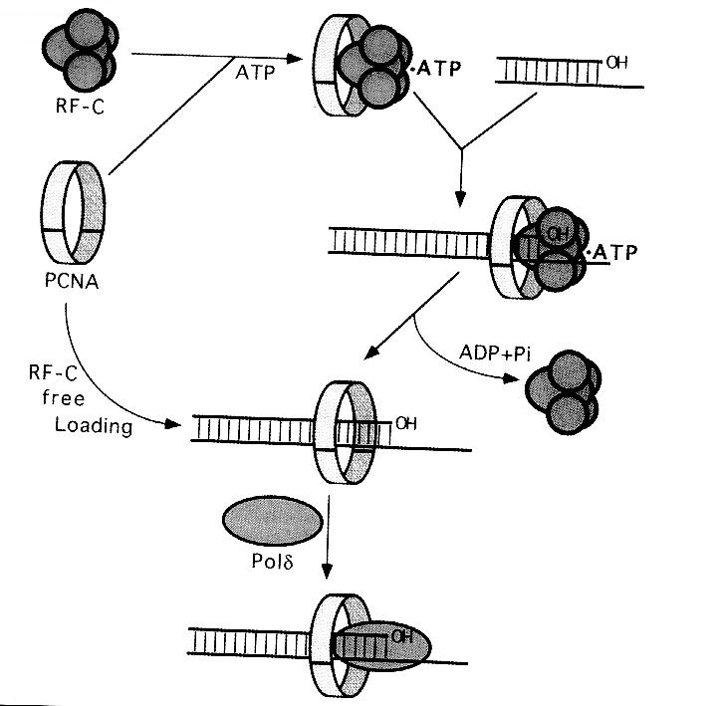
Synthetic lethality Example: the DNA polymerase Clamp
Pol30=proliferating cell nuclear antigen=PCNA
Connie Holm
PCNA=replication clamp. Keeps polymerase
bound to the replication fork
RFC=protein complex that loads the clamp on DNA.
pol30-104 =clamp mutant. Confers slow growth on its own.
pol30-104 is synthetic lethal with mutations in homologous recombination genes!
One of many observations that led to the understanding that recombination proteins play important roles during DNA replication.
Merrill and Holm (1998)
Genetics 148:611-624
Notes:
<number>

Slide 21
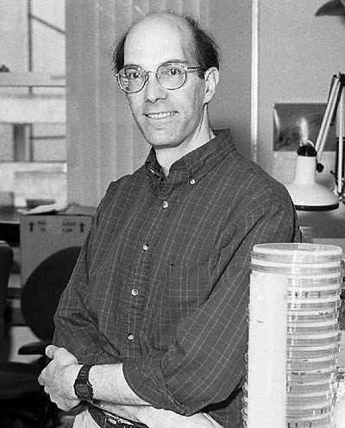
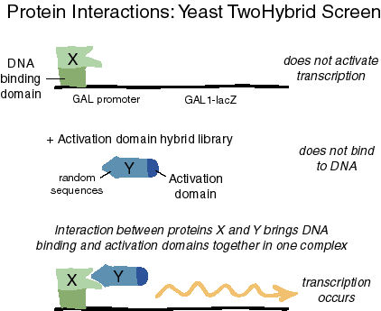

Stan Fields
Eukaryotic transcriptional activators have two modular domains:
Activator domain, DNA binding domain.
Transcription can be activated by association of the two domains,
even when they are expressed on two different polypeptides.
This is a way to test to see if two proteins interact directly!
Roger Brent
Notes:
<number>

Slide 22
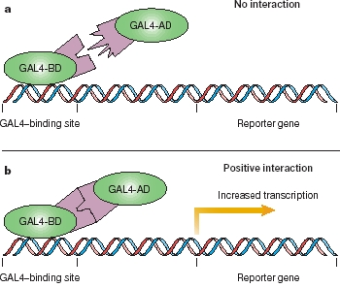
Two-Hybrid Screening
DNA binding domain fusion sometimes called “bait.”
AD domain fusion to a protein or library of proteins called “prey.”
Ask if expression of the two fusion proteins leads to activation
of a reporter.
Make libraries of prey fusions to find proteins that binds a protein of interest “X” which serves
as bait.
For S. cerevisiae this has been done systematically for many pair-wise combinations
Check the Saccharomyces Genome under a gene of interest to
see what its known 2-hybrid interactions are.
NOT RESTRICTED TO YEAST PROTEINS!
TWO-HYBRID LIBRARIES AVAILABLE FOR MANY ORGANISMS
Use yeast genetics to study your favorite protein from ANY organism.
Notes:
<number>

Slide 23
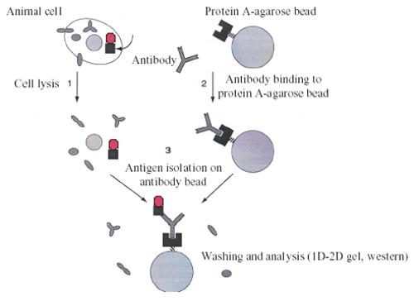
Two-Hybrid Screening
Advantage
-Easy to do.
-Good leads when looking for proteins that interact directly
-Disadvantage…lots of false positives!
Necessary to obtain additional evidence to confirm that a two-hybrid interaction truly reflects direct binding in cells.
Examples of evidence:
Phenotypic similarities of single mutants.
Demonstration that the pure proteins bind one another.
Co-Immunoprecipitation: “pull down” the presumed “prey” protein out of crude cell lysate using an antibody raised against the “bait” protein.
Informatics: Is there prior evidence that the prey protein is likely to be involved in the same biological process as the bait protein?
Co-immunoprecipitation
“Co-IP”
prey
bait
Notes:
<number>

Slide 24
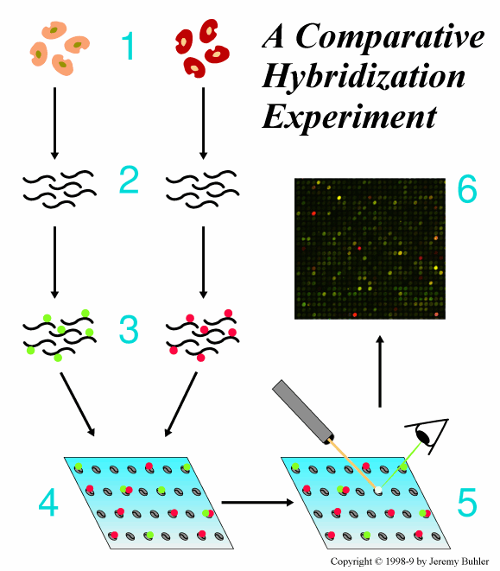
A Genomics Approach: DNA micro-arrays let you measure the level of many mRNAs or DNAs at once
Purify RNA from two populations of cells that differ in some interesting way. (e.g. wild type cells vs. mutant cells, growth on medium containing some substance vs. not containing that substance)
Reverse transcribe to DNA and tag DNA with a fluorochrome: red for one (control), green for the other (test).
Hybridize DNA to a micro chip that carries an array of ssDNA oligonucleotides that correspond to the expressed region of every gene.
Measure red and green fluoresence across the chip
Analyze relative levels to see if expression on the test sample goes up or down relative to the control.
Notes:
<number>

Slide 25
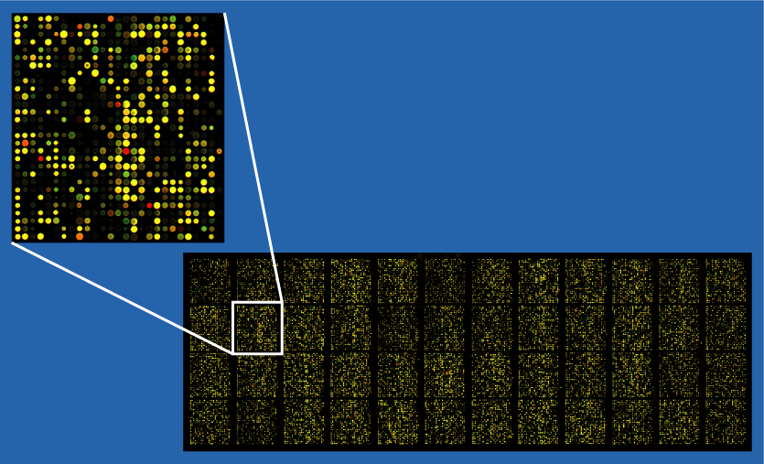
A Genomics Approach: DNA micro-arrays let you measure the level of many mRNAs or DNAs at once
Yellow=no change.
Red=less mRNA in the test sample than in the control
Green=more mRNA in the test sample than in the control.
Hybridization Arrays dominated the field from around 2000 to 2010, but is now becoming obsolete.
Still taught because of the huge volume of data available from array experiments.
Need to be careful about the quality of the data. Are experiments done in
triplicate?
Transcription profiling a particular powerful way to study the targets of a
transcription factor. How would you do this?
Extremely detailed phenotypic snap shot of a
cell.
Aside: valuable method for cancer typing/prognosis
Notes:
<number>

Slide 26
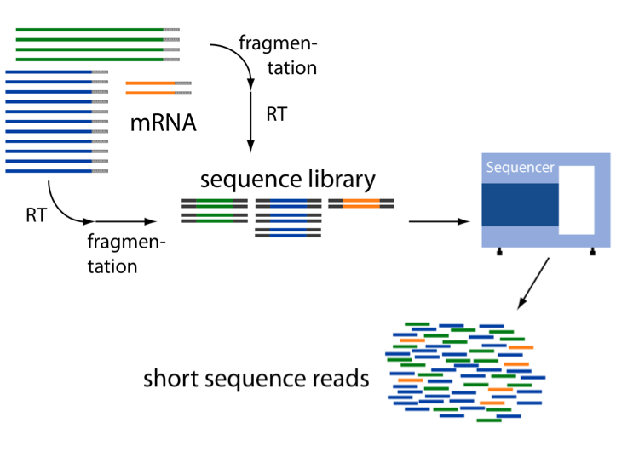
RNA sequencing (RNA seq) also allows measurement of mRNA levels for all genes at one time.
RNA seq. is rendering array methods for transcription profiling obsolete. The method is as a consequence of advances in high throughput DNA sequencing analysis. RNA seq=Easier, cheaper, faster, less prone to artifact.
In this case, RNA is reverse transcribed, and then solid phase high-throughput sequencing is used to read the sequence of a large number of cDNA molecules.
If enough cDNAs are read, the frequency of each “read” provides a profile of the abundance of each gene.
Best to compare data from 2 samples as with hybridization arrays.

Slide 27
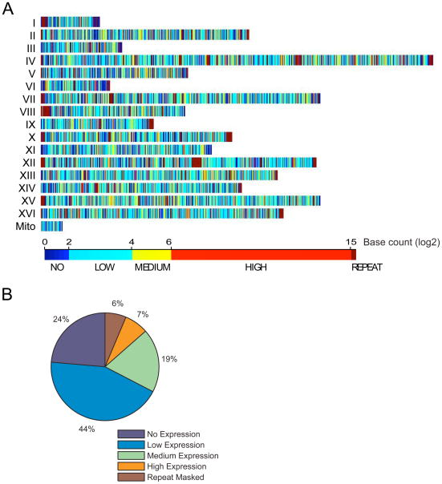
Yeast Transcriptome
Nagalakshmi, U., Wang, Z., Waern, K., Shou, C., Raha, D., Gerstein, M., & Snyder, M. (2008). The Transcriptional Landscape of the Yeast Genome Defined by RNA Sequencing. Science (New York, N.Y.), 320(5881), 1344–1349. http://doi.org/10.1126/science.1158441

Slide 28
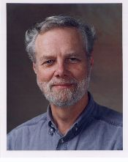
Real “Functional” Genomics
Knock out every yeast gene one at a time.
Make a collection of mutants.
Each strain carries 2 unique tags or “bar codes”
Ron Davis
tag1
forward primer
KAN^{R}
use PCR to amplify KAN^{R}
primers are designed to have several functions
in addition to being able to direct amplification
of KAN^{R} (next slide).
reverse primer
tag2
KAN^{R}
X
X
Giaever et al. Nature 418,
387-391 (2002)
YFG⁺
KAN^{R}
Yfg::KAN^{R}
Notes:
<number>

Slide 29
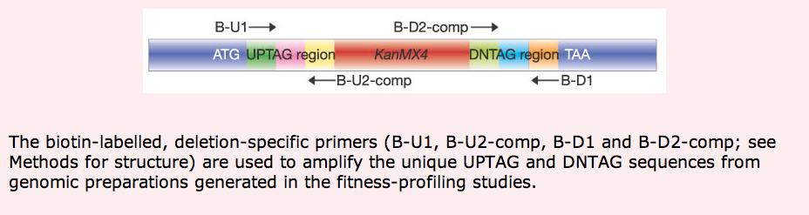
Bar Code to identify specific Knock-out strains
forward primer region
reverse primer region
Pink and cyan regions contain a unique pre-designed
“bar code” that uniquely identifies the gene.
Both bar codes for each knock-out construct are flanked
by a pair primers that are the SAME for all knockout constructs.
Green and yellow are short primer regions that allow reading the upstream bar code. Light green and orange are short primers regions that allow reading the down stream bar code.
The dark blue regions are the left and right homology arms that are needed to target the knockout mutation as we learned previously. In this case homology arms were very short –i.e. oligonucleotides were used with about 30 nt of homologous sequence.
Notes:
<number>

Slide 30
Scheme for finding genes required for a particular growth condition
Take entire KO collection as a mixture of strains in liquid.
Grow under desired condition (e.g. galactose as a carbon source).
Purify DNA from cultures.
Amplify bar codes using the two bar code primer pairs to get a collection of pcr products that reflects the representation of each knockout construct in the mixed population.
Hybridize to a microarray. This time, oligos for each bar code that are arrayed rather than oligos for each mRNA.
Look for codes that are under-represented in the mix. Weak signal for a given bar code feature in the array provides evidence that the corresponding mutant strain is under-represented in the test sample vs. the control (i.e after growth on galactose vs. growth on glucose as a source of sugar).
One array data set gives you all the mutations that block growth under the condition tested.
Notes:
<number>

Slide 31
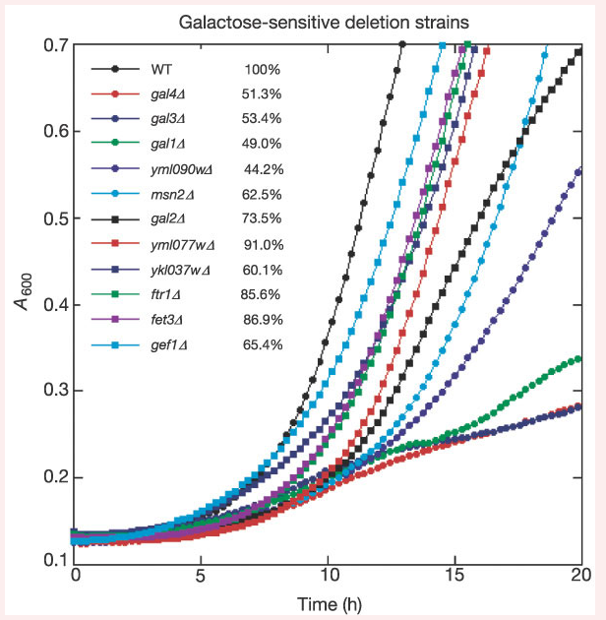
Selection of KO collection for growth on galactose medium identifies new genes needed for growth on galactose
Confirm that the missing strains in the micro-array analysis truly are
slow growers in galactose medium.
Individual knock out strains tested.
This shows that the method works!
i.e. one can find all the genes required for normal growth under a given condition by assaying the relative representation of each mutant in a mixture, following growth of that mixture under the relevant condition.
Notes:
<number>

Slide 32
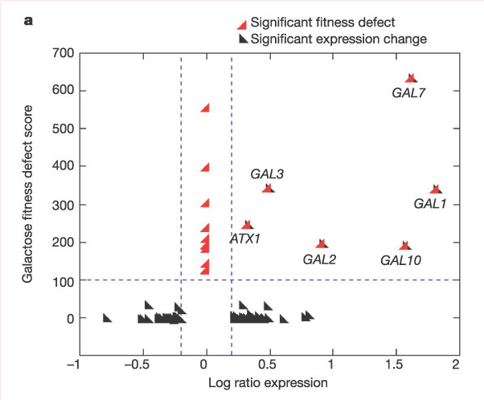
Low level of correlation between expression level and functional importance.
Davis and colleagues made surprising observations by comparing gene expression vs. functional importance of genes.
Many genes known to be required for growth on galactose ARE transcriptionally-induced on galactose medium.
BUT…..there are lots of genes whose expression increased on galactors that are NOT required for growth on galactose.
Furthermore, there are genes that are required for growth on galactose that are NOT trascriptionally induced by galactose.
Transcriptional induction does NOT imply
functional importance under the conditions of induction!
Beware of studies that assume functional importance on the basis of transcriptional regulation alone.
Important lesson from budding yeast that is not well appreciated!
In some systems you can use expression profiling to enrich for genes that are functionally important, but in some you cannot!
Notes:
<number>

Slide 33
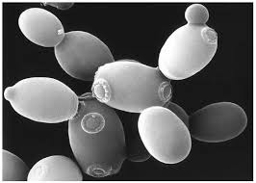
Budding Yeast
Fast, cheap.
Genetically powerful.
Advanced Genomics Tools.
Advanced cell biological tools.
Large repository of high-throughput data.
Huge research community.
Proven model for eukaryotic biology.

Slide 34
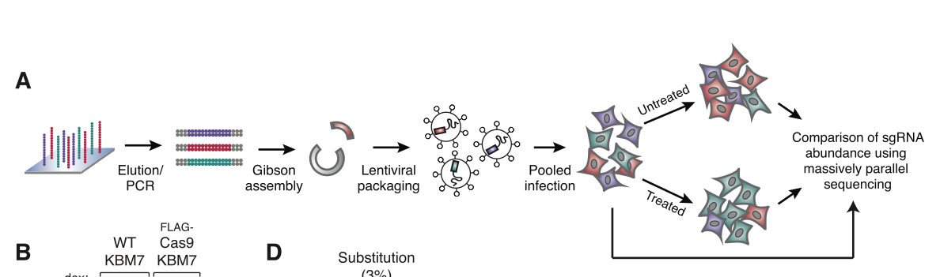
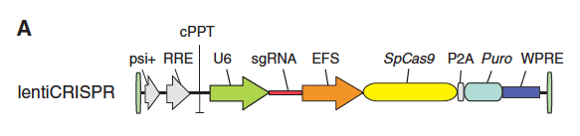
Revisit CRISPR Cas9 Construction of a Lentiviral library for expression of sgRNAs against human genes
The Lander and Zheng labs at MIT both created libraries of sgRNAs using high throughput oligonucleotide synthesis and Gibson assembly.
The libraries were created in lentiviral vectors to allow efficient introduction of the genes into human cells
Create a mixed population of human cells in which different cells express different sgRNAs.
Lander’s group introduced the library into cells that already harbored an inducible cas9 gene.
Zheng’s group engineered the vector to express Cas9 along with each different sgRNA. Zheng’s library can be used to infect any cell line of interest.
Wang, et al. (2014). Science , 343(6166), 80–84.
Shalem et al. (2014) Science: 343 (6166), 84-87.

Slide 35
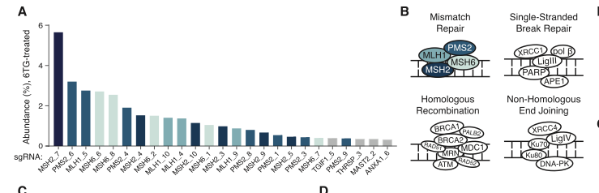
Selection for loss of function of the mismatch repair pathway using sgRNA/sgRNA/Cas9 -induced mutations
The mismatch repair machinery is unable to repair 6-thioguanine. When it attempts to carry out repair, the process stalls, leading to arrest of the cell cycle.
Mutants lacking the mismatch repair machinery make no attempt to repair 6-thioguanine and are able to grow.
Grow library of infected cells on 6-TG.
High through-put sequencing to see what sgRNAs are enriched.
Find that sgRNA mediated targeting of the 4 major mismatch repair genes leads to enhanced growth on 6-TG.
No enrichment with any other DNA repair pathway was targeted, as expected.
Indicates able to carry out saturation mutagenesis on using a previously characterized genetic selection method.
Powerful forward genetics in human cells!!!!

Slide 36
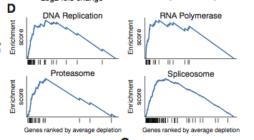
Screening for essential functions
Compared library cells expressing Cas9 to cells not expressing Cas9.
Ask which sgRNA targets are essential by looking for depletion of bar-codes by deep sequencing. (Like the method Ron Davis used in yeast).
Found high frequency of depletion of tags for genes known to be essential in processes such as DNA replication, RNA metabolism, and protein stability.
Proof in principle that the method can be used for genetic screening for loss of function.
Now possible to do powerful genetic screens and
selections in human tissue culture cells.

